Slide 1

Password Manager
COMP:SEC.300 Secure Programming
Julia Ruoranen

Slide 2

Introduction
Basic Password Manager to safely store passwords
Programming language Python
GUI made by using Python’s library Tkinter, desktop application
Data is stored in SQLite3 database
Notes:
Application’s idea and functionalities are pretty basic: passwords from different apps or websites can be saved safely in one place where the user can view, add, modfy and delete passwords.
My choice of programming language was Python and Graphical User Interface was done with Python’s own library Tkinter.
It is a desktop application where the data is stored in SQLite3 database.

Slide 3
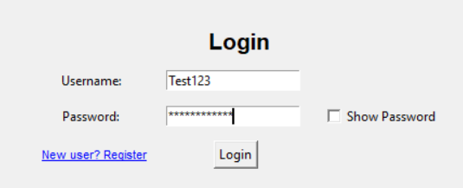
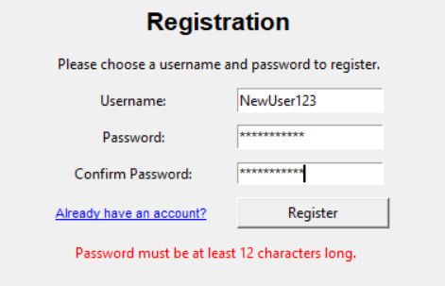
Login and Registration
Simple login-view:
Entries for username and password
Inputs are chekced and errors informed with red text
New users can move to the registration view easily
Simple registration-view:
Enties for new username, password and password confirmation
Inputs are checked and possible errors informed with red text
It is possible to move back to login-view
Notes:
Next I am gonna present all functionalities and views
Let’s start with Login and Registration:
Both are simple view where login-credentials are asked
If something went wrong, the reason is informed with red text (example in registration picture)
User can move between login- and registration-views
After registration user needs to login before main-view opens

Slide 4
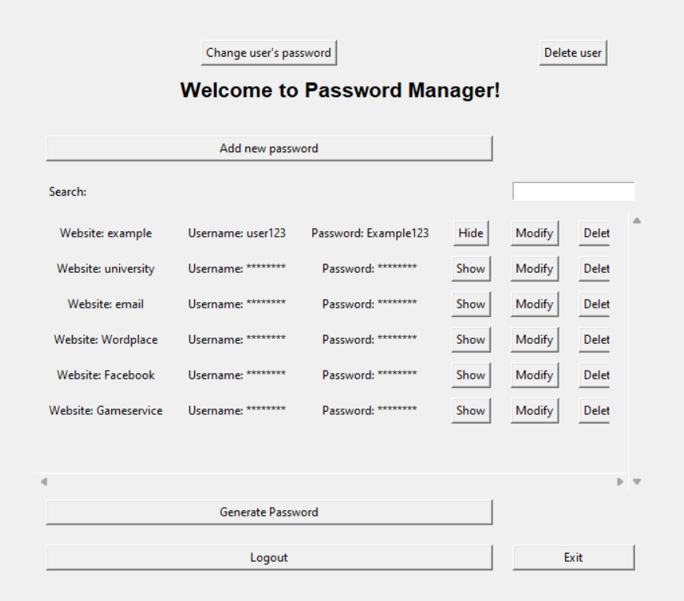
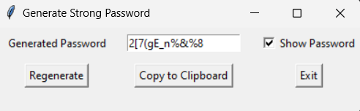
Main view
Contains the basic functionalities:
Viewing the password information
Searching certain password
Modifying the password
Adding new password
Deleting certain password
Generating strong password
Logging out and exiting the program
Most of the buttons open new view or popup window
Notes:
Main-view contains the list of password information:
The usernames and passwords can be viewed by clicking ’View’ button
Password can be modified by clicking ’Modify’ button
Password and all related information can be deleted by clicking ’Delete’
Popup window askes if the user wants to confirm the deletion
Certain password can be searched using ’search’ field (search is done based on website name’)
User can also add new password, modify users password and delete the whole account
User can also generate strong password and copy it for use
Logging out and exiting are also possible

Slide 5
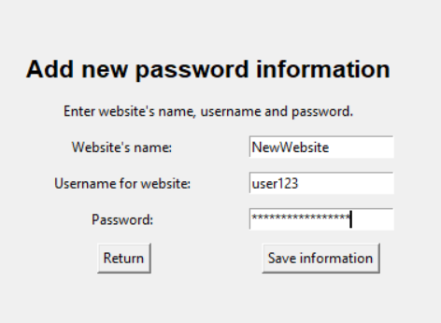
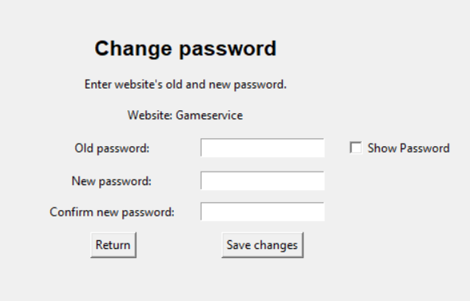
Adding and modifying passwords
Adding new password:
Website name, username and password have their own entries
All of the entries must have information before the save-button can be clicked
Modifying existing password:
Old password is asked and checked before changing the password
If validated, save-button saves the changes to the database
Notes:
Adding and modifying passwords have both there own views:
While adding the password, user feeds all information related to it and the data is stored to the database
While modifying password, the old password is first confirmed and after that the new password is updated to the database

Slide 6
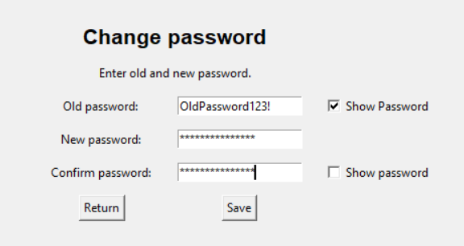
Changing user password
It is important that the user can change the login-password
Old password is asked and confirmed before the password can be changed
The new password is updated to the database and at the same time all saved passwords’ encryption is updated
After succesful password change, the user is logged out

Slide 7
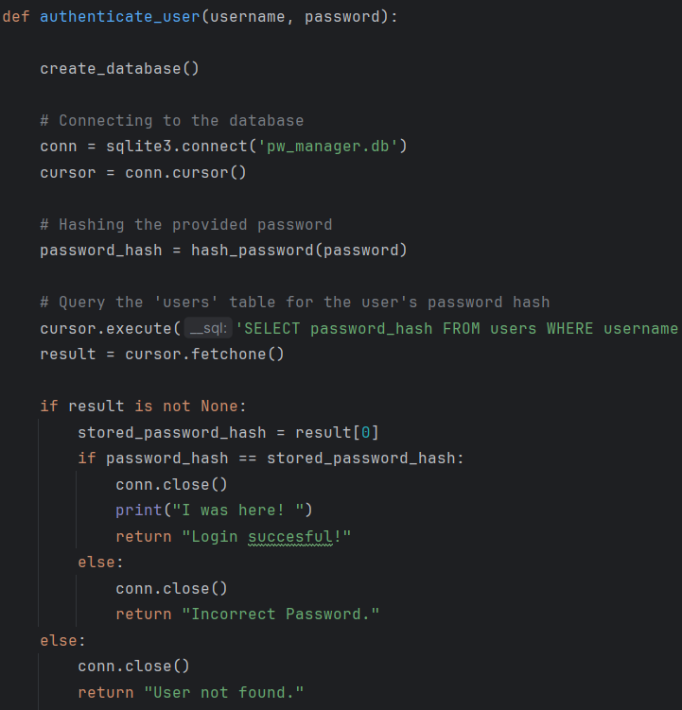
Authentication
Usernames uniqueness is checked
Password is validated (lenght, character diversity)
Before registration some input validation is done
User’s existance is checked
Password is hashed and compared to the database one
Inputs are validated beforehand
Notes:
Next we can go more into the application’s security solutions: First authentication
In registration and authentication phase words pretty simple: In registration the usernames uniqueness is checked from the database
The password is hashed and the hashed password is stored into the database with username and other user information
In Login-phase user existance and the password are checked: the feeded password is hashed and then compared to the database’s password
In support of authentication there are all sort of input and password validation solutions, which are presented in the next slide

Slide 8

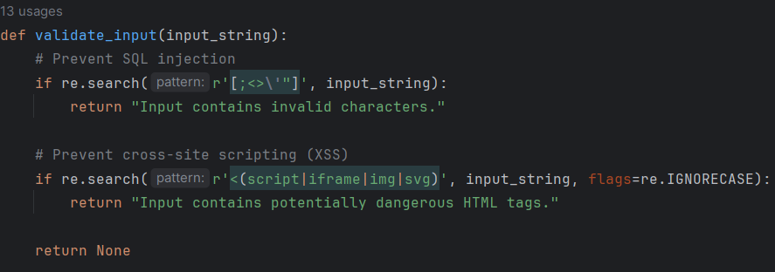
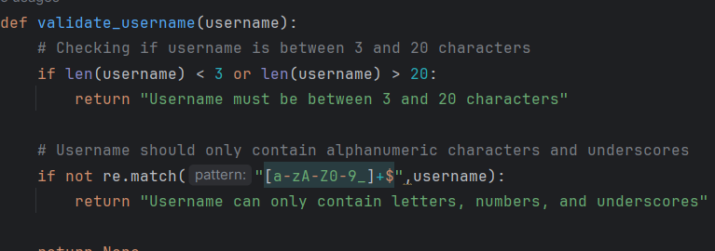
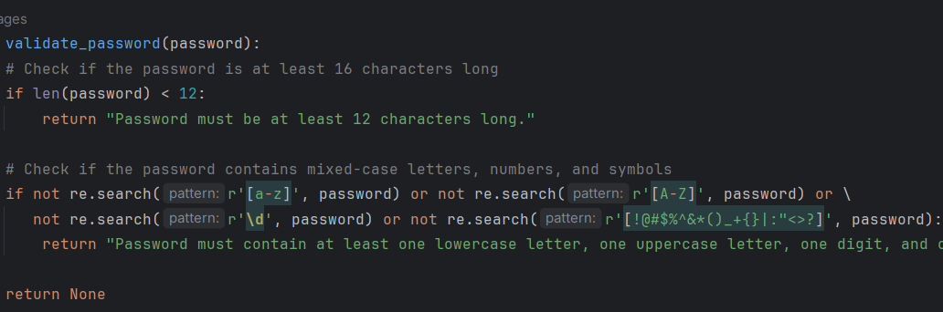
Validating inputs
SQL injection and XSS are checked before authentication
Password is validated (length and character diversity)
There is also small validation for username
Notes:
As mentioned all information user feeds are validetad: In the login and registration but also when adding or modifying information.
All user’s inputs are feeded to the database so before that the input needs to be validated from SQL injections and cross-site scripting.
In registration phase the password is also validated: it needs to inlude 12 or more character, has upper- and lowercase letters and numbers + special marks -> more secure password
There is also some validation for the username but not as strict because it is not used to secure anything

Slide 9
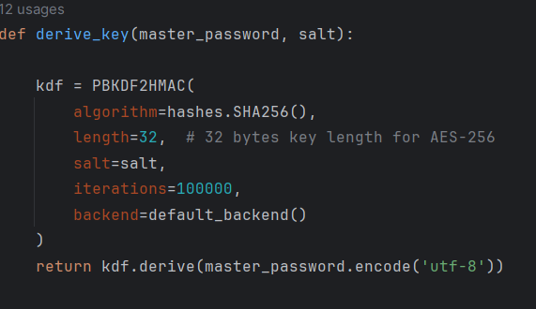
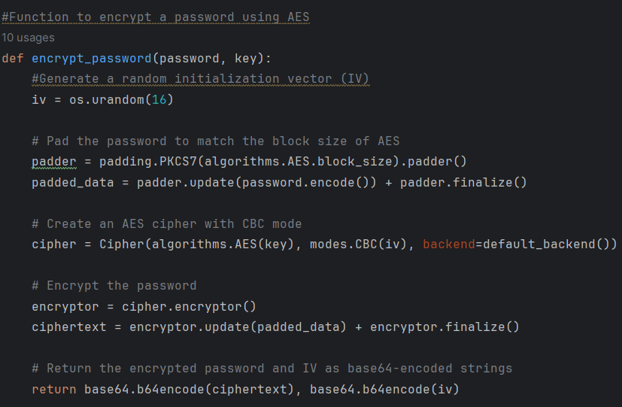
Encryption
Stored passwords are encrypted with master password
Key derivation function PBKDF2
The encryption algorithm AES 256 with CBC mode
Master password created randomly and encrypted with the login-password
Notes:
One of the most important part of the security is encrypting the passwords.
Master password is used to encrypt the stored passwords
Master password is created in the registration phase: it is randomly generated password that is then encrypted with the login-password (seperate from the login-password)
The used key derivation function is PBKDF2 and the encryption algorithm is AES 256 with CBC mode
When the user wants to view the certain password it is decrypted at that moment: means that the master password needs to be stored because it is constantly needed both in viewing the passwords and secondly adding and modifying the passwords.
If user changes the login-password, the master password is changed at the same time and all the stored passwords are encrypted with the new master password (also while user changes the login password, the user is logout at the same moment.

Slide 10
Testing
Testing a bit in progress
Plan is to test manually at least:
Authentication
Cryptography
Input validation
Data access
Designing tests is new for me, that’s why there is only manual testing
Notes:
Testing is still a bit in progress but basic idea is to make some manual testing related to the authentication, cryptography, validation and data access related tasks
Designing testing for programs is a bit new for me so that is why there is only some manual testing, nothing more

Slide 11

Summary
Password Manager enables secure password storage and management in one centralized location
Strong encryption and input validation techniques are used to ensure the confidentiality of the sensitive data
In addition, strong passwords can be generated for more secure password usage in other platforms
Notes:
This password manager stores and manages password in centralized location
Strong encryption ensures the datas confidentiality and input validation locates some of the used attack methods
In addition strong passwords can be generated and these can be used in other platforms and in that way secure the data in other places as well

